Slide 1


Growth Between
GDP and
Olympic Performance
for Given Countries
Joshua Bacon-Qaunaq
#3720274

Slide 2
Contents
Introduction
Hypothesis
Outcome Prediction
Medals Over Time
GDP Over Time
Data Analysis
Comparison
Prediction Versus Reality
Results
Conclusion

Slide 3


Introduction
For this class, I decided that I wanted to test whether or not it was viable to say that GDP has an effect on Olympic performance.
It would make sense to come to this conclusion before analysis is done due to many reasons, such as; a decrease in rates of poverty, increased access to social securities, increased access to higher training for physical activities, etc.
Thus I will state a hypothesis to base my analysis off of, predict the outcome, and then do the analysis as well as determining the validity of the prediction and hypothesis.
https://www.factscrush.com/2023/03/facts-about-gdp.html
https://goodgifvs.life/product_details/28181491.html

Slide 4

Hypothesis
My hypothesis is that- with using a multiple line graph model, I will be able to represent the relationship between the two variables that change over time being GDP and Olympic performance.
In doing so, GDP and Olympic performance should have a correlation as they both go forwards in time.
If this is true, then a country should have either a better performance in the Olympics when GDP is rising, or GDP will rise if a country has a good performance in the Olympics.
https://www.freepik.com/icon/line-graph_3954728

Slide 5


Outcome Prediction
I predicted that there will be a strong correlation between the growth of GDP and Olympic performance.
On the other hand, I think that if my prediction is wrong, a country will actually be inversely affected.
Although, there could be outliers that can have statistical significance on the outcome, in which case I cannot predict the outcome, this is possible as the Olympics happen in 2-4 year intervals and a lot can change in that time.
Correlation
https://icon-icons.com/icon/two-up-arrows/74227
Inverse
https://www.freepik.com/icon/switch_466154

Slide 6
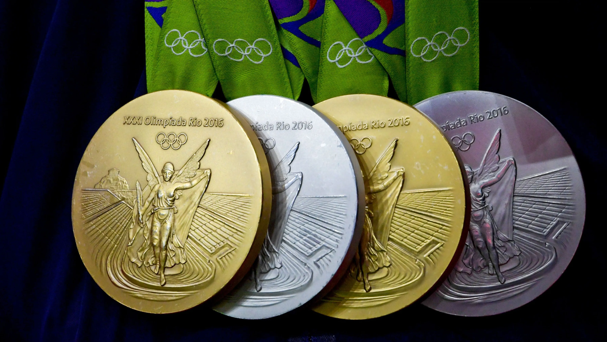
Medals Over Time
For this test, all that was needed from the data was the Year, Team, and Medal.
First, selecting by a specific country, and then sorted by time and merged for total winnings in a year.
Plotted on a simple plot, then plotted with other countries.
https://www.kaggle.com/datasets/heesoo37/120-years-of-olympic-history-athletes-and-results
https://www.usatoday.com/story/sports/olympics/2017/05/23/rio-olympic-games-medals-defective-show-rusting-chipping/102048222/

Slide 7
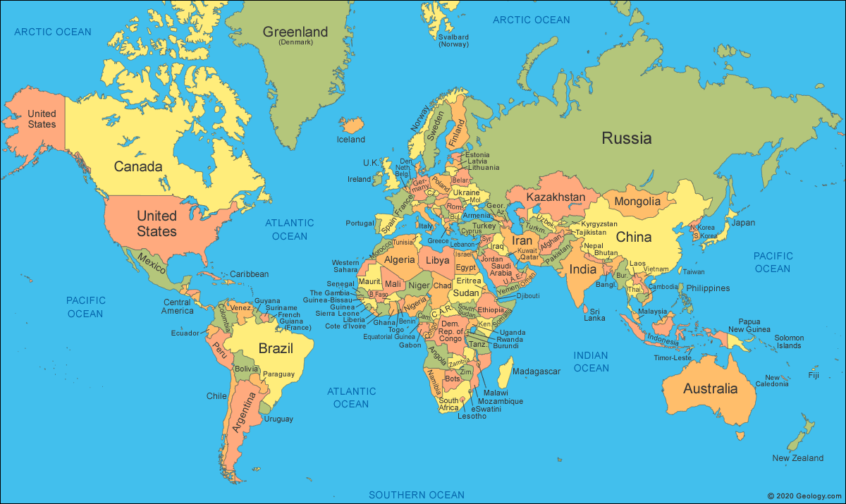
GDP Over Time
For the GDP test, Year, Country and GDP was required.
Starting by selecting by a specific country, the data was transposed for simplicity, and removed the years without the Olympics.
Plotted on a simple plot, then plotted with other countries.
https://data.worldbank.org/indicator/NY.GDP.MKTP.CD
https://geology.com/world/world-map.shtml

Slide 8

Data Analysis
The data from both databases will be looked at and fixed independently before being able to interact.
This is to ensure that the data can be compared together in terms of the correct years.
This is also to ensure that the correct countries are being compared.
https://repository-images.githubusercontent.com/603848052/af587679-8db6-4b1b-a3a7-80c8a45af9a2

Slide 9
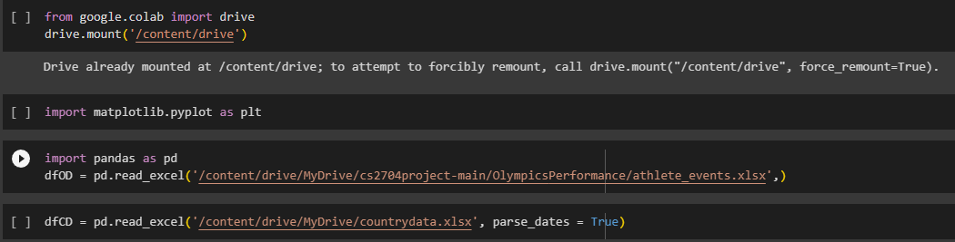
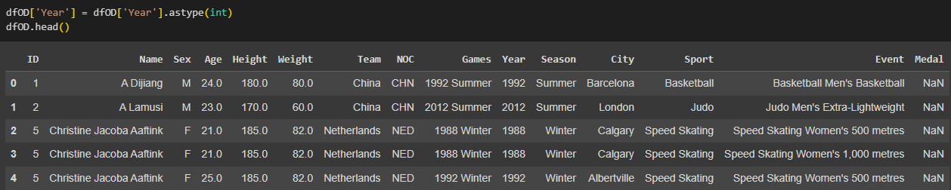
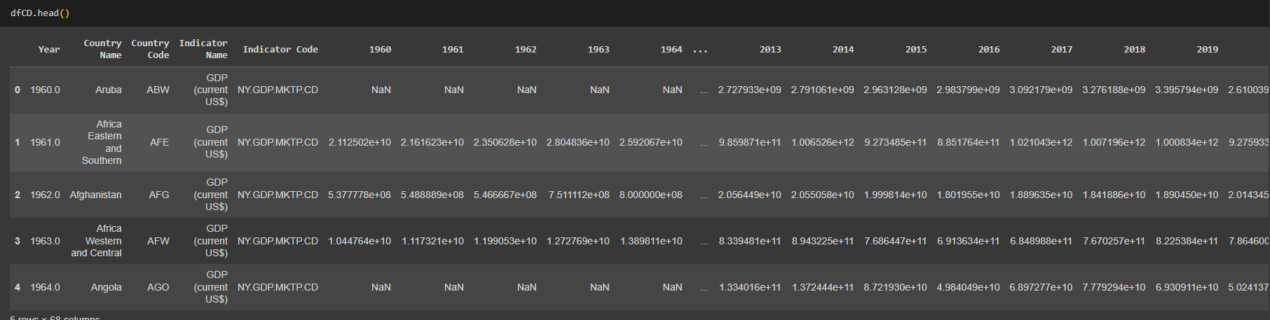
Data Analysis Database

Slide 10
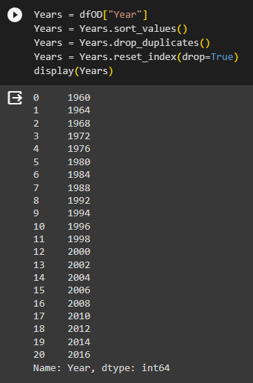
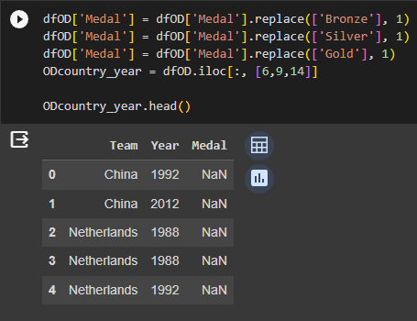
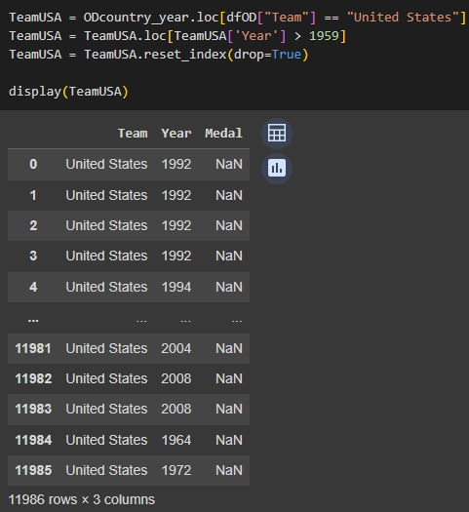

Data Analysis Framing

Slide 11
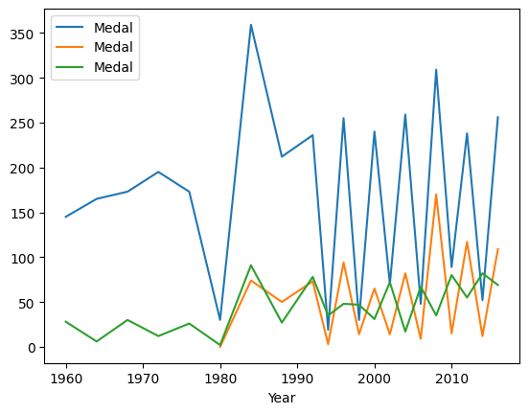
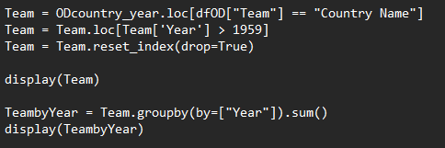

Data Analysis “Untouched” Plot Olympics
USA
CHN
CAN

Slide 12
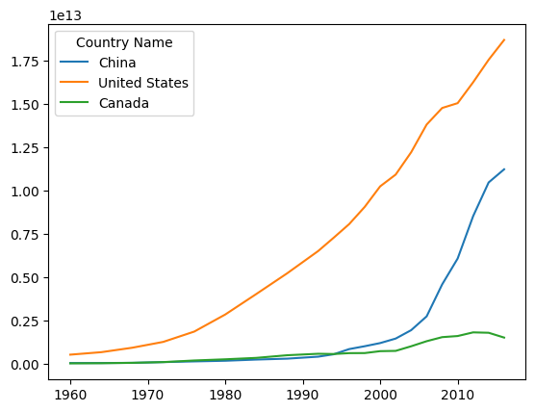
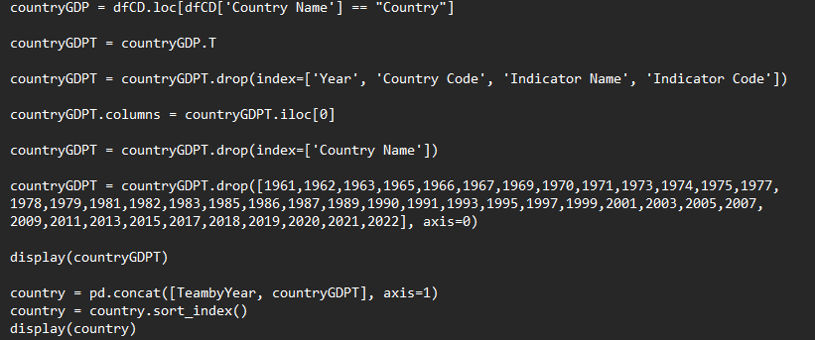
Data Analysis “Untouched” Plot GDP

Slide 13
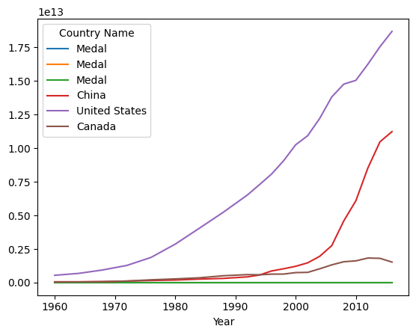
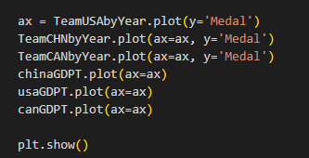
Data Analysis “Untouched” Both Data Frames
USA
CHN
CAN

Slide 14
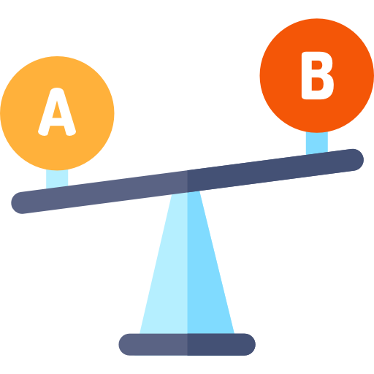
Comparison
The amount of wins in the Olympics will not compare well to the GDP of a country, this is because the numbers are so different.
To fix this, we must a normalization method such that a value in the hundreds can compare to a value in the trillions which will allow us to determine if there is a correlation.
We can also denoise the data to make it fit better along the curve to determine if there is a correlation between the parameters.
https://www.flaticon.com/free-icon/comparison_923051

Slide 15
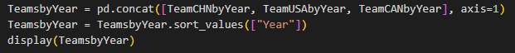
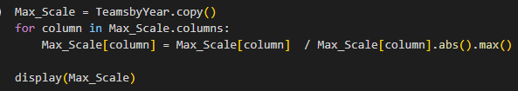

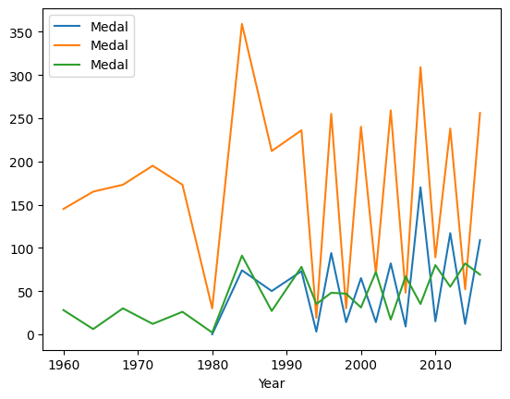
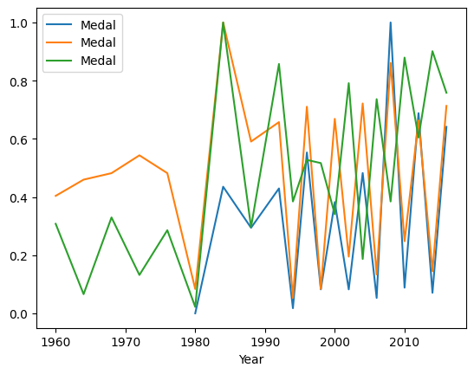
Comparison Olympics
CHN
CHN
USA
USA
CAN
CAN

Slide 16

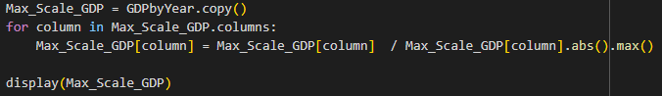

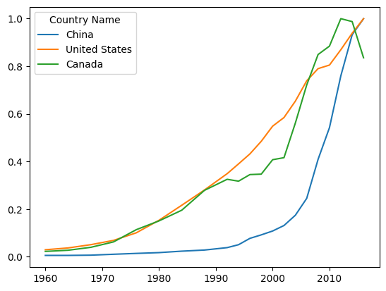
Comparison GDP

Slide 17
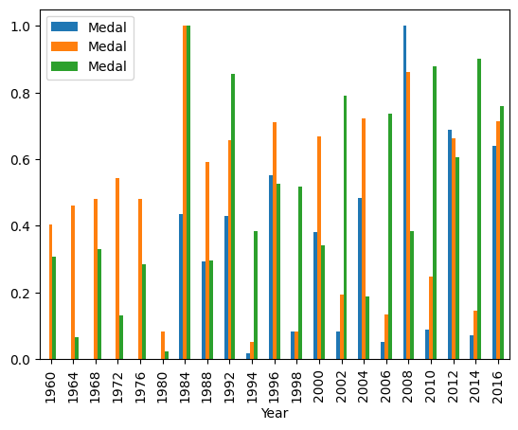
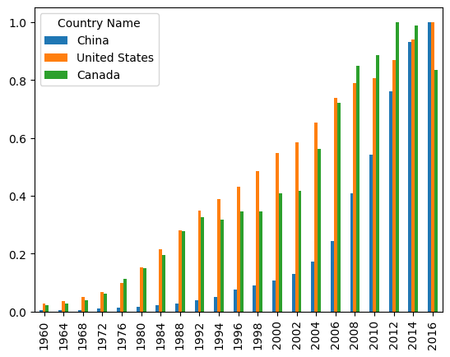
Comparison Bar Charts
CHN
USA
CAN

Slide 18
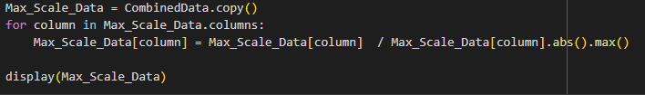

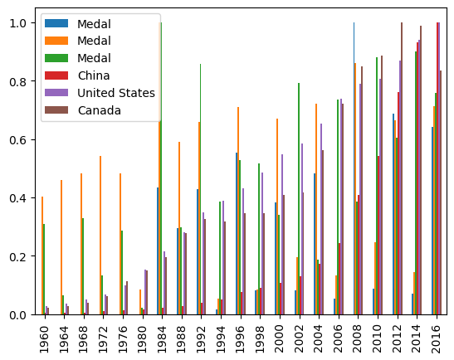
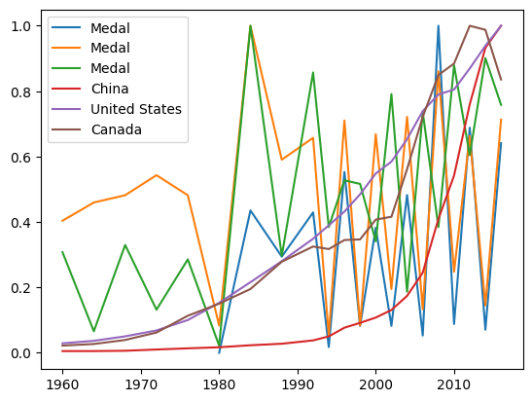
Comparison of Both
CHN
CHN
USA
USA
CAN
CAN

Slide 19
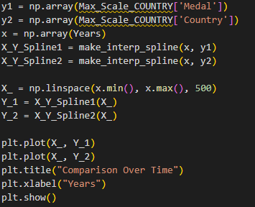
Comparison Normalized

Slide 20

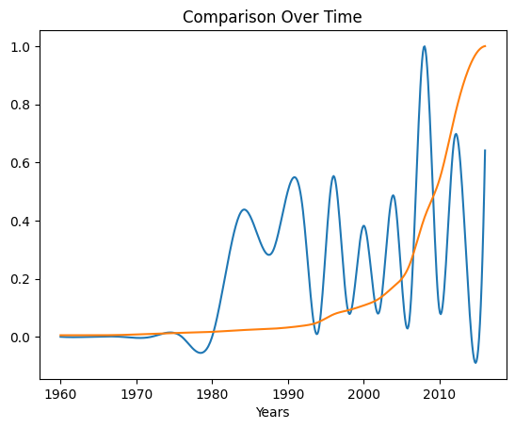
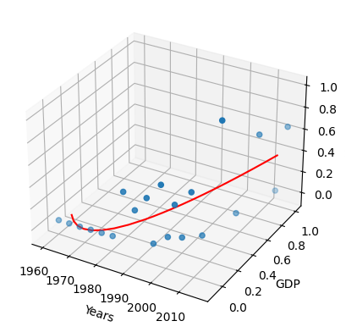
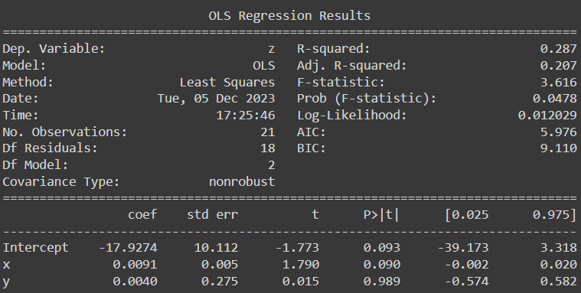
Comparison China

Slide 21

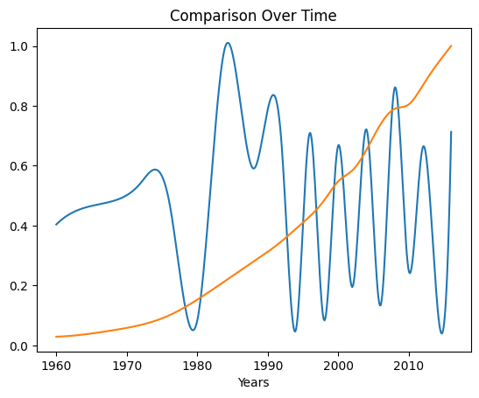
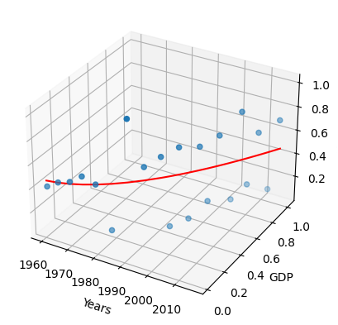
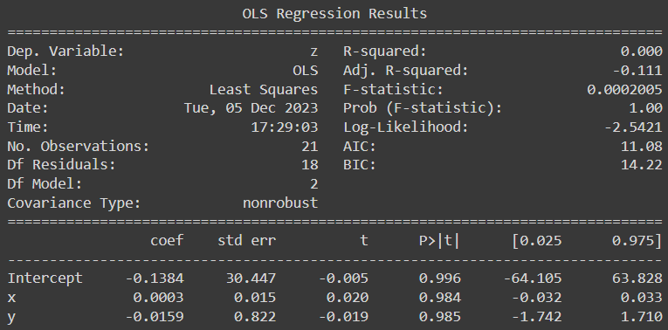
Comparison USA*

Slide 22

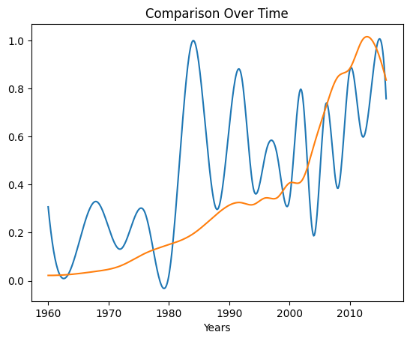
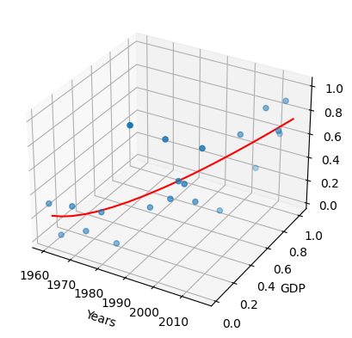
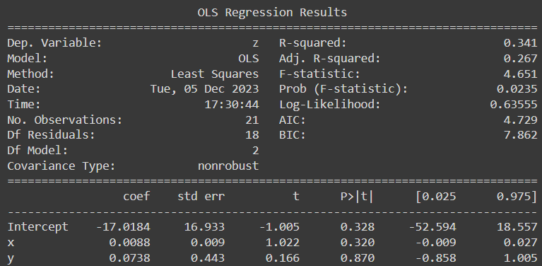
Comparison Canada*

Slide 23
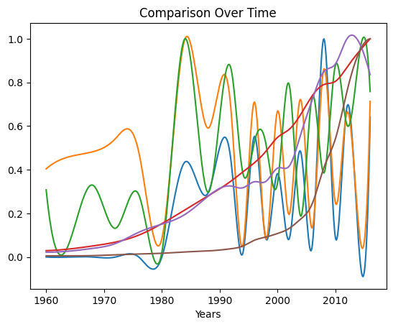
Prediction Versus Reality
As one can tell from the variability of the graph, the result is that there is hardly any correlation between winning medals in the Olympics and GDP.
We can then state that the hypothesis is false and that there is no correlation between these attributes.
Although, there does seem to be large dips and large peaks throughout this graph, does this mean anything?

Slide 24
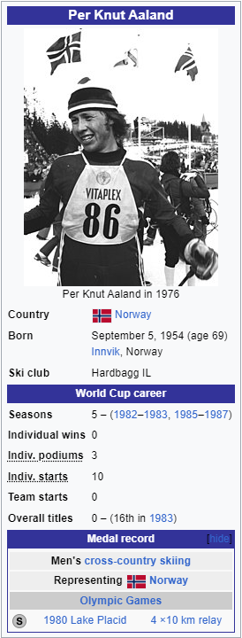
Results
There were almost no correlations between the parameters, although some countries may have had a somewhat correctly predicted rise on average such as Canada.
While some countries follow this prediction, not all countries follow such trends.
The peak years had interesting histories behind them.
While going through these results and comparing to other sources, there were some false hits for medals in the Olympics Database.
https://en.wikipedia.org/wiki/Per_Knut_Aaland

Slide 25
Results: Interesting Years
1980: Olympics were boycotted.
1984: Olympics after major boycott that introduced professional athlete participation, sports and countries.
1992/1994: Olympics had no boycott for the first time in 3 decades, and dramatic changes in politics across europe affected the Olympics, Olympics started being bi-yearly.
2002: Olympics occurred a year after the terrorist attack in 2001.
2004: Olympics had all countries with a national olympic committee in attendance.
2008: Olympics took place in Beijing which allowed China to show it’s rise as a power in the world.
And so on…

Slide 26
Conclusion
There was the fact that some of the athletes were attributed to the wrong teams, there was not enough time to fix this and the amount of wins recorded and actual wins were similar enough to feel safe in using.
While there was not much of a correlation between GDP and Olympic performance of a country, perhaps this idea would still apply to another metric besides GDP.
If this test were conducted on another parameter that is closer to politics, then the comparison might fit better.
The data that would be used is the quantified relationship between participating countries and the host country of that year. While this data would be difficult to produce, this data would most likely be the best fit for the comparison.

Slide 27
References
https://www.britannica.com/event/Moscow-1980-Olympic-Games
https://www.si.com/olympics/2021/06/03/la-84-olympics-changed-the-games-daily-cover
https://www.britannica.com/event/Barcelona-1992-Olympic-Games
https://www.nytimes.com/2002/02/24/sports/2002-games-riveting-sport-and-an-angry-backlash.html
https://www.britannica.com/event/Athens-2004-Olympic-Games
https://olympics.com/en/olympic-games/beijing-2008

Slide 28

Thank You!
Questions?
https://medium.com/agileinsider/how-to-ask-questions-effectively-3f9b43cee6a2

